Slide 1
Year 10 2018
Information Session
Wednesday 19th July 2017
Linda McDonald –Deputy Principal Learning and Teaching

Slide 2
Freedom Prayer
Loving God, creator of us all.
We give thanks for the many opportunities given to us to develop the gifts we have been given.
In this year of Freedom, may we grow in acceptance of ourselves and others. Help us to serve one another humbly and to work to secure an equal opportunity for all.
May we work sincerely, harmoniously and collectively in the pursuit of happiness and freedom, for being free is a continual journey fueled by love, felicity and acceptance.
In challenging all that restricts our God–given freedom, may we let go of fear and open our hearts to love so that we may truly find the courage to be free. May we find resilience in the face of challenge.
Let it go. Let it be. Only then shall we be truly free.
Amen.

Slide 3
Year 10
Building a strong foundation to Senior Secondary pathways
We offer:
Comprehensive core of subjects
Covering all key learning areas
Allowing some choice in the curriculum through the elective program.

Slide 4
Senior Secondary Options at
Loreto College
Three possible pathways/combinations:
VCE – Victorian Certificate of Education
VCAL – Victorian Certificate of Applied Learning
VET – Vocational Education and Training

Slide 5
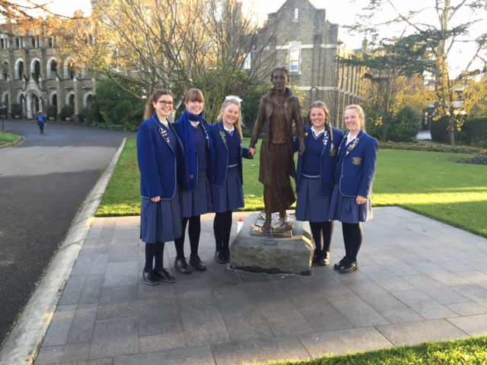
Year 10
Block 1 – Core Studies
Block 2 – Electives

Slide 6

Core Studies
Religious Education
English
Mathematics
Science (minimum 1 semester)
Humanities
Strive

Slide 7
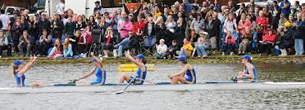
All girls need to maintain a balance between
academic study, Career planning and physical health/mental health
Strive

Slide 8


All girls will complete Year 10 English for the whole year.
They can choose to try English Literature or English Language as an Elective if they wish.
English

Slide 9
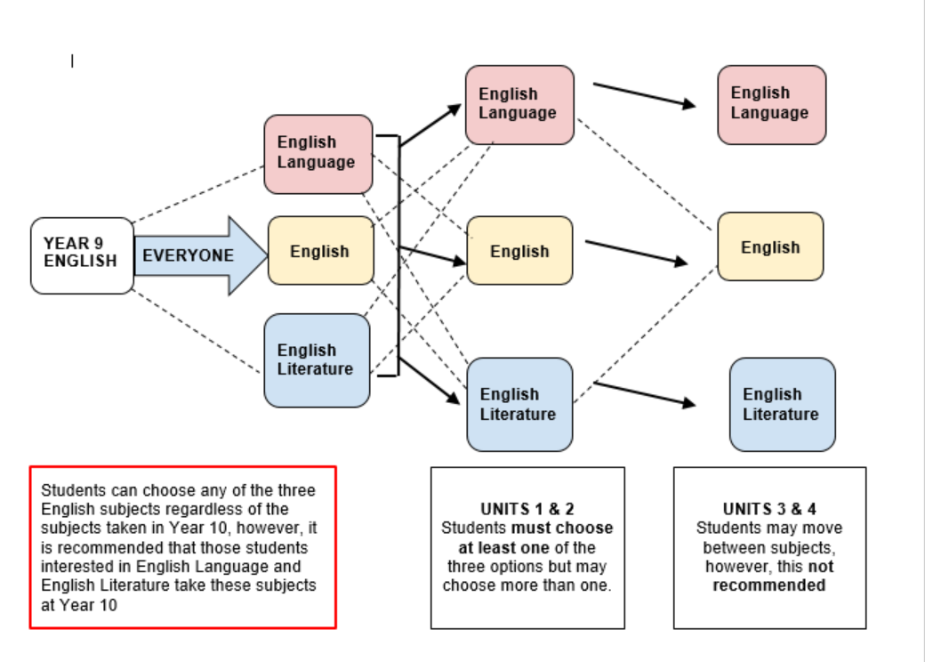
English Flowchart

Slide 10
Mathematics
Mathematics A
Mathematics B
VCE General Mathematics Unit 1&2 *
* Students will need to apply to take this subject.

Slide 11
Mathematics Flowchart

Slide 12
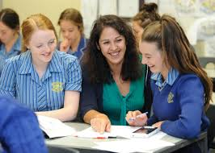
Mathematics
Each girls is required to talk to her current Mathematics teacher and obtain their recommendation and signature.
Also, talk to Mrs Wheaton, if necessary
Letter of recommendation in Term 3

Slide 13
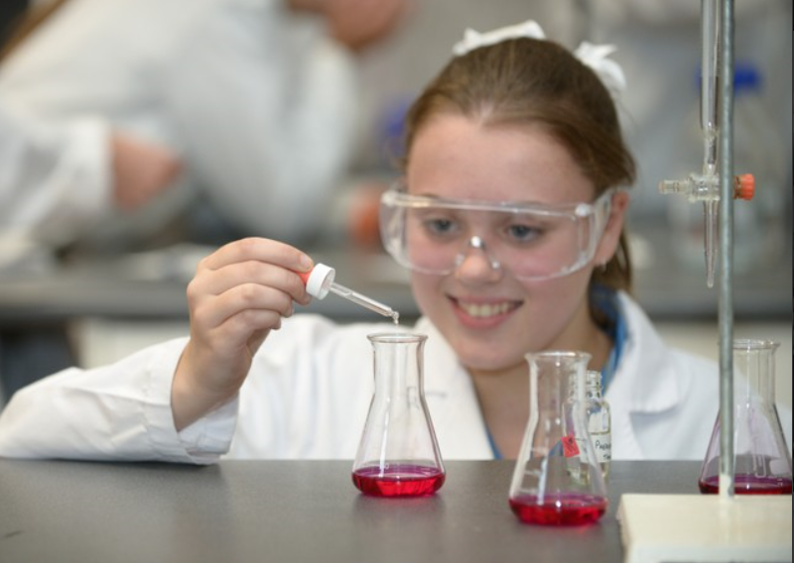
Science
Each girl can choose the type of Science they would like to study from the following:
General Science
Applied Science
Pre-VCE Chemistry
Pre-VCE Biology
Pre-VCE Physics
Pre-VCE Agricultural Science
(note Sports Science
does not count as a Science)

Slide 14
Science
Minimum of one semester of Science.
Can choose more than one, recommended that you try a couple of Sciences if you wish to continue with Sciences in VCE
Talk to your current Science teacher and please obtain their recommendation and signature.

Slide 15
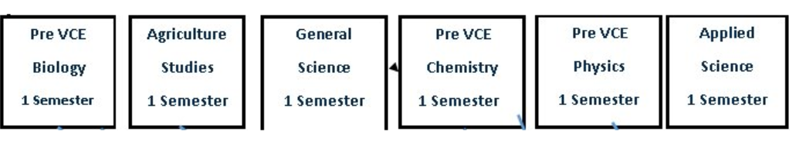
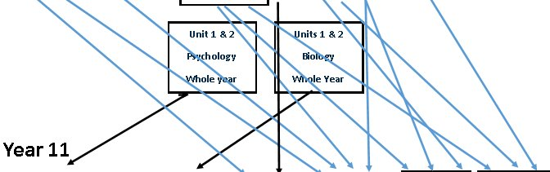
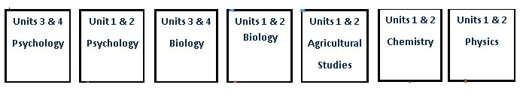
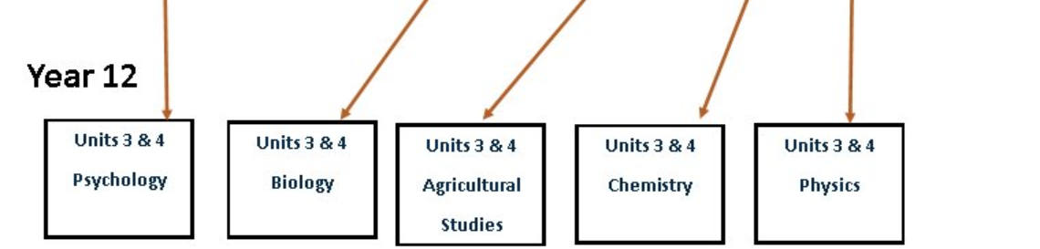
Year 10 Science

Slide 16
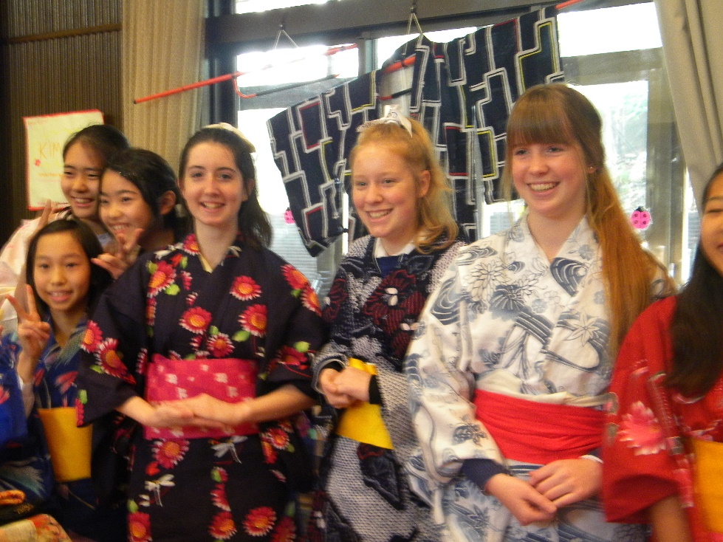
LOTE: French or Japanese
Certificate II in Applied Language from VSL
You must complete the LOTE for the whole year.
LOTE study score in VCE units 3 and 4 (Yr.12)
is scaled very favourably.

Slide 17
Certificate II in Applied Languages
(French & Japanese)
Unit Competency 1
Conduct basic oral communication for social purposes
Unit Competency 2
Conduct basic workplace oral communication
Unit Competency 3
Read and write basic documents for social purposes
Unit Competency 4
Read and write basic workplace texts

Slide 18
Pathway of Senior Languages
Year 9
French
Japanese
Year 10
Certificate II in Applied Languages
Year 11
Unit 1 & 2
French
Japanese
Year 12
Unit 3 & 4
French
Japanese

Slide 19
Electives Studies
9 Key Learning Areas.
Rigorous and help prepare the girls for Senior Secondary Pathways.
Each elective 9 periods per fortnight for one semester.
Girls can access to VCE Units 1 and 2 (yr.11) for the whole year.

Slide 20
Electives Studies
 | Core subjects | Electives | Electives | Electives
Semester 1 | Religious Education English Mathematics Humanities (History & Geography) Strive | Health | Commerce | Music Performance Ensemble
Semester 2 |  | Pre-VCE Biology | Legal Studies | Food and Technology

Slide 21
Sample Electives Choices
 | Core subjects | Electives | Electives | Elective VCE
Semester 1 | Religious Education English Mathematics Humanities (History & Geography) Strive | General Science | LOTE | Unit 1 Biology
Semester 2 |  | Art | LOTE | Unit 2 Biology

Slide 22
Electives Studies
 | Core subjects | Electives | Electives | VCE
Semester 1 | Religious Education English Mathematics Humanities (History & Geography) Strive | Health | Art | Unit 1 Business Management
Semester 2 |  | Applied Science | Drama | Unit 2 Business Management

Slide 23
For students thinking about applying to study a VCE Unit 1 / 2 in Year 10
Need ‘Excellent’ or 85% + in relevant Year 10 subject(s)
Year 9 teachers will be asked to comment on work habits:
- classroom organisational skills
- completion of home study
- classroom behaviour
- ability to meet due dates
Create a portfolio of your best work to show me.
Apply on-line before the 1st August 2017

Slide 24
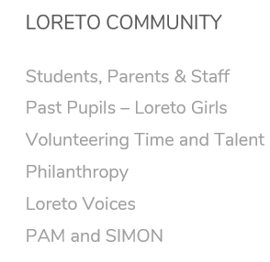
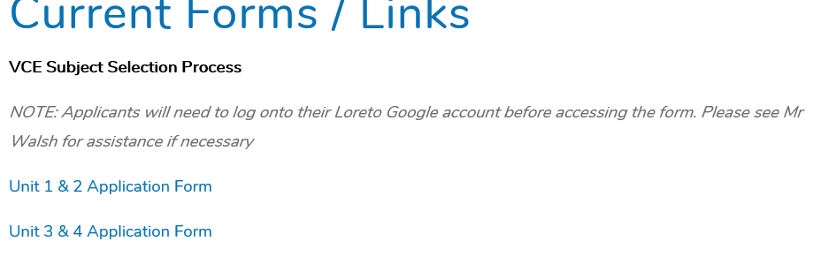
How do I apply for a Unit 1 & 2?
To apply to study a Units 1 and 2 subject in Year 10 students will need to complete an on-line form which can be found on the College website
Students will also participate in an interview with one of the Deputy Principals and or mentor teacher.

Slide 25
Preparation for Subject Selection
Session with Ms. McDonald (last term)
Read the Information Book carefully
3. Year 9 Mentoring sessions- during Melb exp weeks.
4. Talk to current teachers and obtain their recommendations.
5. Discuss subjects with:
  Parents
  Subject teachers
  Faculty leaders
  Mentor teacher
  Careers teacher

Slide 26
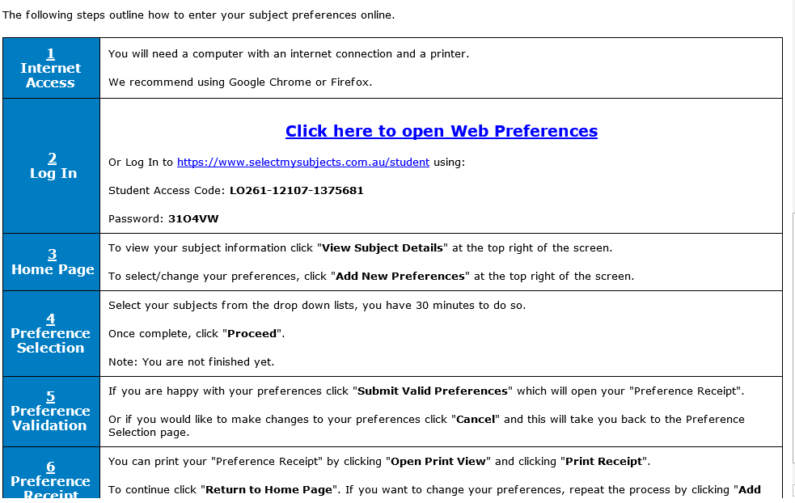
How do I submit my subject preferences?
You will get an email like this:

Slide 27
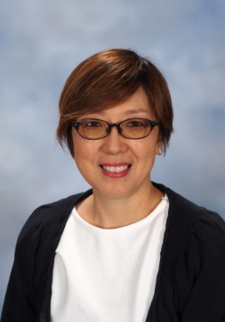
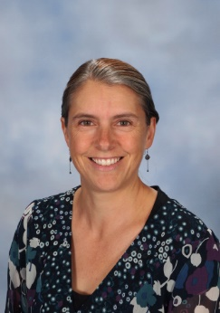
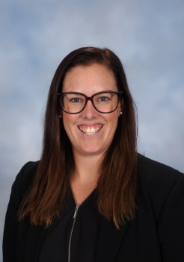
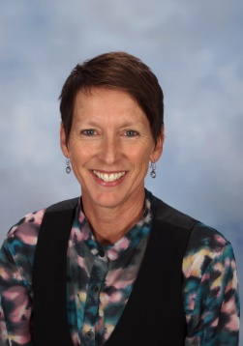
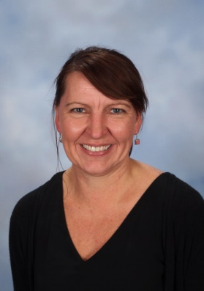
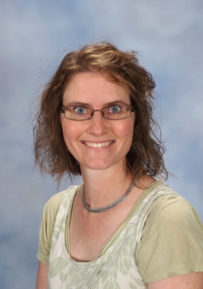
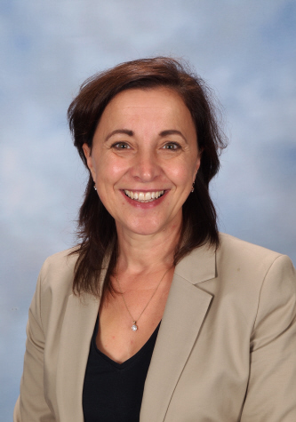
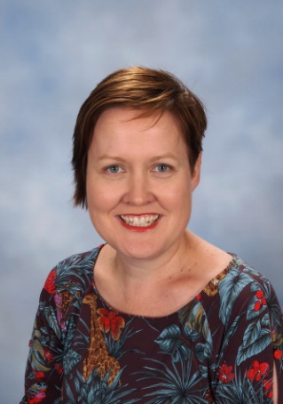
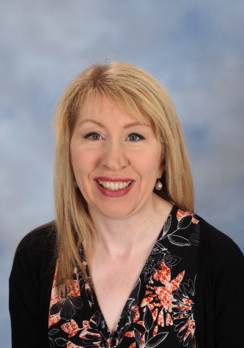
Unit 1 & 2 Applications due on line 1st August
Year 10 2018 subject due on line Wednesday 23rd August
Mathematics
Paula Wheaton
Languages
Yoshie Burrows
English
Jenna Larkin
Health and PE
Carmel Parker
Science
Natalie Howard
The Arts
Stephanie Greet
Technology
Thea Mooney
Religion
Felicity Knobel
Humanities
Jayne Carrigg

